Slide 1
Phrase-based Knowledge Sentiment Graph, Applications and In-Progress Work
Fanchao Meng
Postdoctoral Research Associate
Biocomplexity Institute
University of Virginia
mf3jh@Virginia.edu
Mark Orr
Research Associate Professor
Biocomplexity Institute
University of Virginia
mo6xj@virginia.edu

Slide 2
Why PKSG?
Motivation:
Semantic representations for social media texts at multiple granularities (e.g. phrase, sentence, document and corpus).
Social media texts are typically short and not well written.
Sentiments for arbitrary aspects (e.g. vaccination and wearing masks)
Aspects are manually specified or automatically detected.
Interface semantics/sentiments to individual relationship graphs.
For any given subgraph, semantics/sentiments can be captured.
End Goal (beyond PKSG): Understand dynamics of semantics/sentiments, graph structures of individual relationship graphs and their interactions.

Slide 3
Why not other semantic representations?
Embedding methods?
Distributional hypothesis.
Token? Sentence? Document?
Semantic drift? Scenario-specific?
Sufficient data for training and fine-tuning?
Interpretable?
Parse-tree-based methods?
Syntactic structures.
Computationally expensive (both in time and space) to handle full parse trees.
Not as friendly as embeddings for downstream modeling.

Slide 4
What is PKSG?
A graph capturing both semantics and sentiments
Syntactic structures + Distributional hypothesis
Nodes: “Phrases”
Segments extracted from argument structures
Edges: Co-occurrences of “Phrases”
Predetermined scope of context (e.g. tweet)
Sentiments:
Computed on edges (by using sentiment models)
Aggregated on nodes (resulting in generalized aspect-based sentiments)

Slide 5
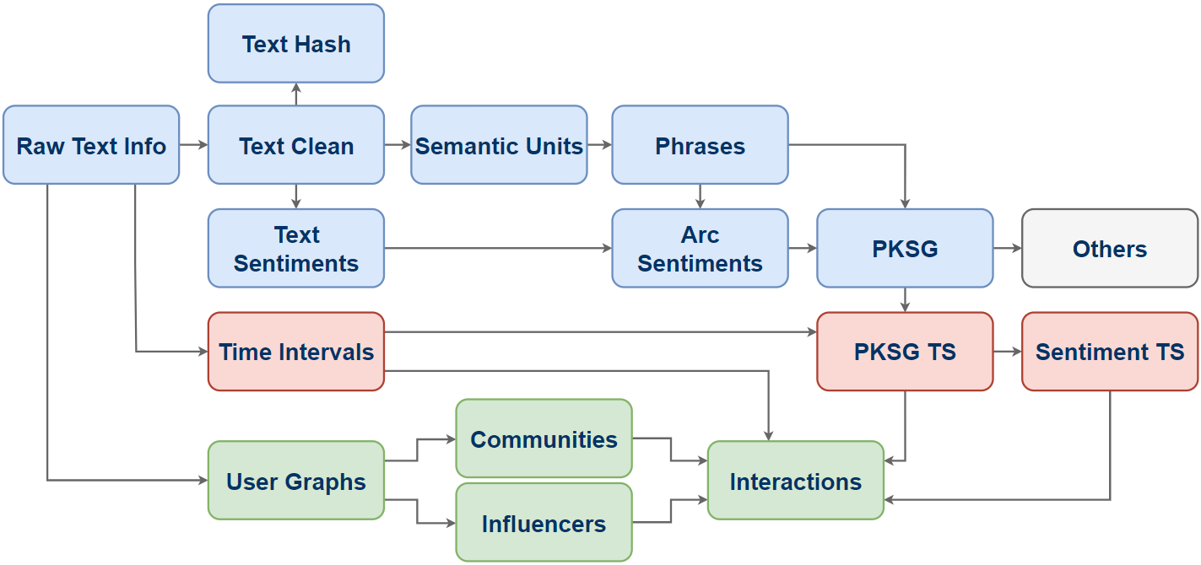
PKSG Pipeline: Overview

Slide 6
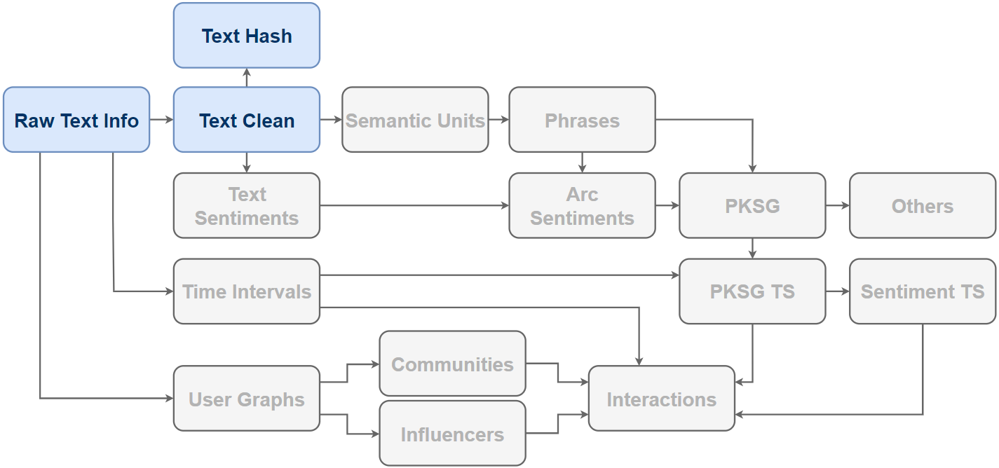
PKSG Pipeline: Overview
Text preprocessing & Indexing.

Slide 7
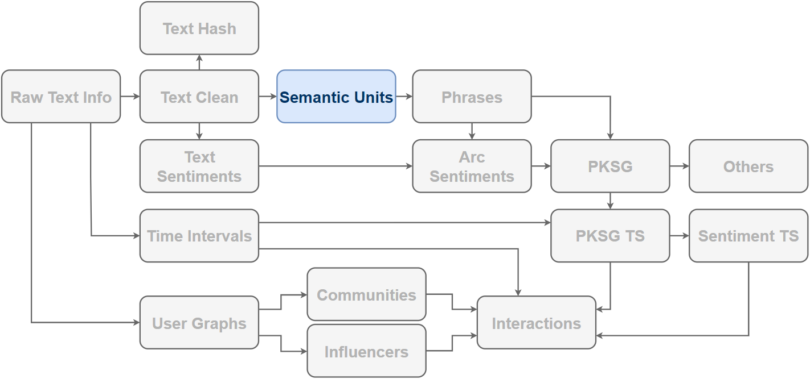
PKSG Pipeline: Overview
Simplify syntactic structures obtained from dependency parse trees.

Slide 8
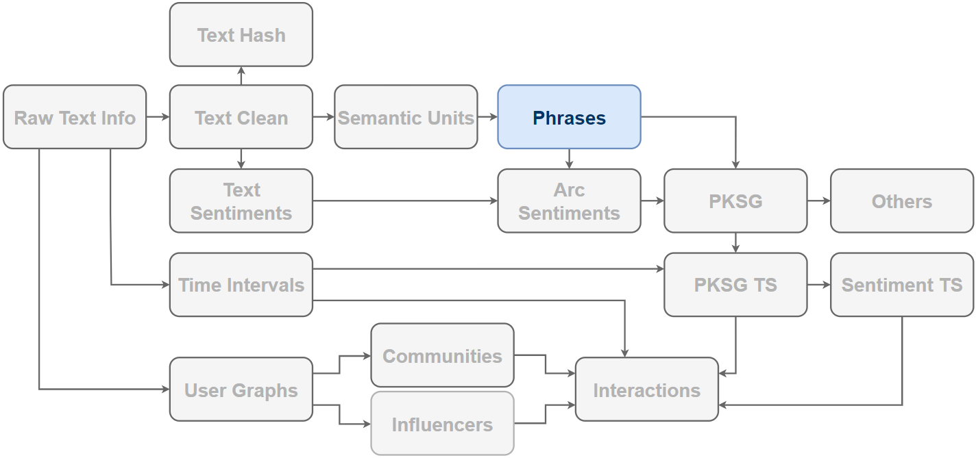
PKSG Pipeline: Overview
Extract segments from semantic units.

Slide 9
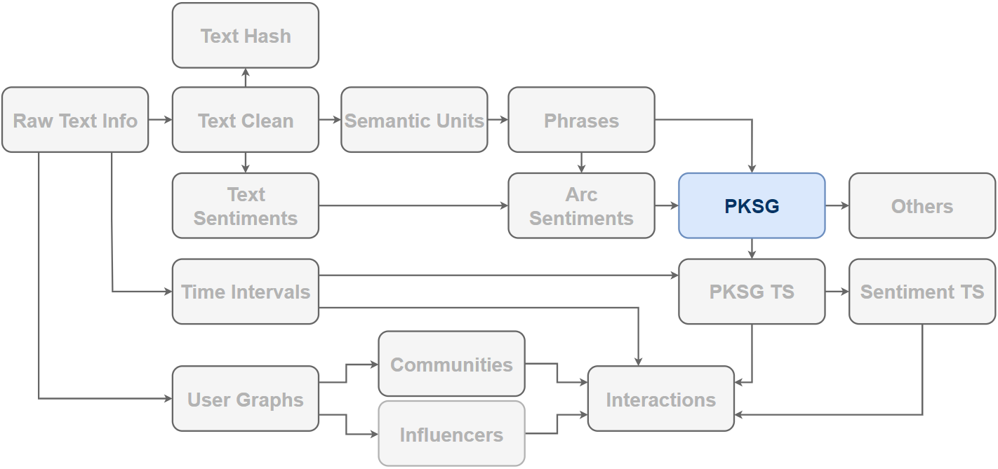
PKSG Pipeline: Overview
Build a graph on phrases. Edges are created by co-occurrences of phrases.

Slide 10
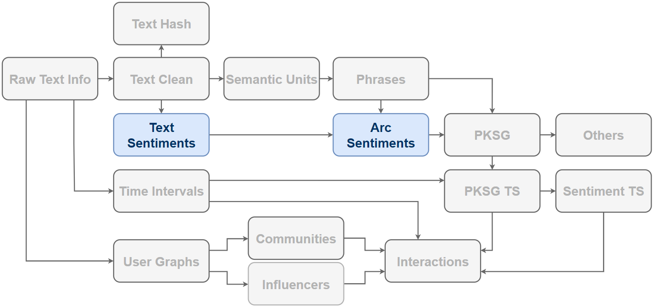
PKSG Pipeline: Overview
Compute sentiments on edges.

Slide 11
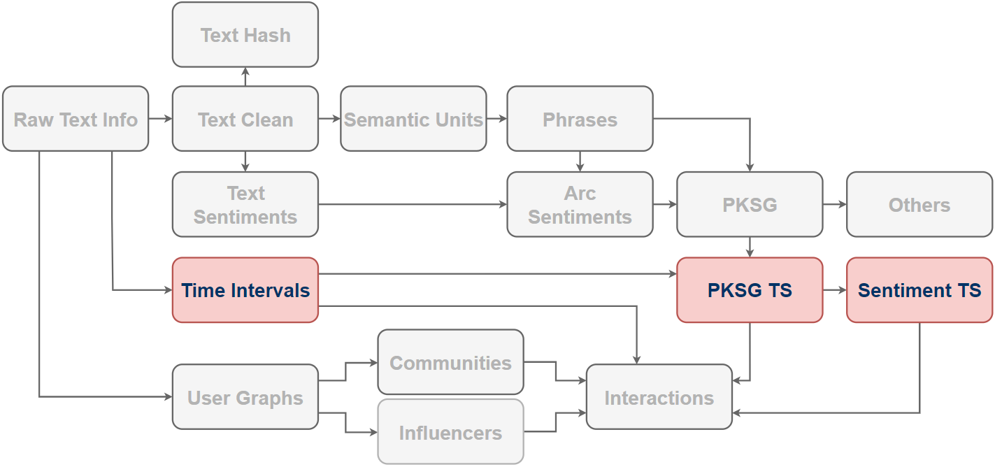
PKSG Pipeline: Overview
Build a time series of PKSGs, and compute sentiments for a given aspect by aggregations over incident edges of aspect nodes.

Slide 12
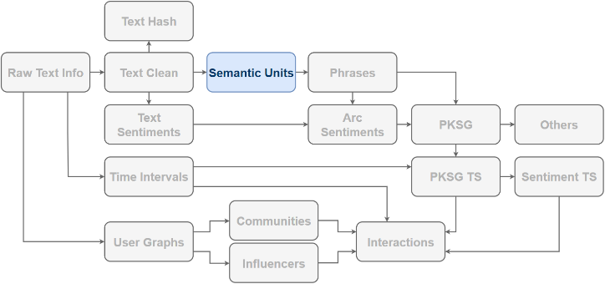
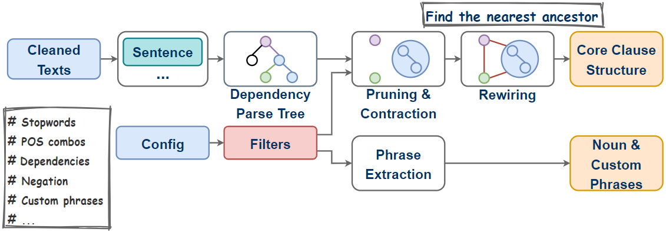
PKSG Pipeline: Semantic Units
Not the final phrases yet!

Slide 13
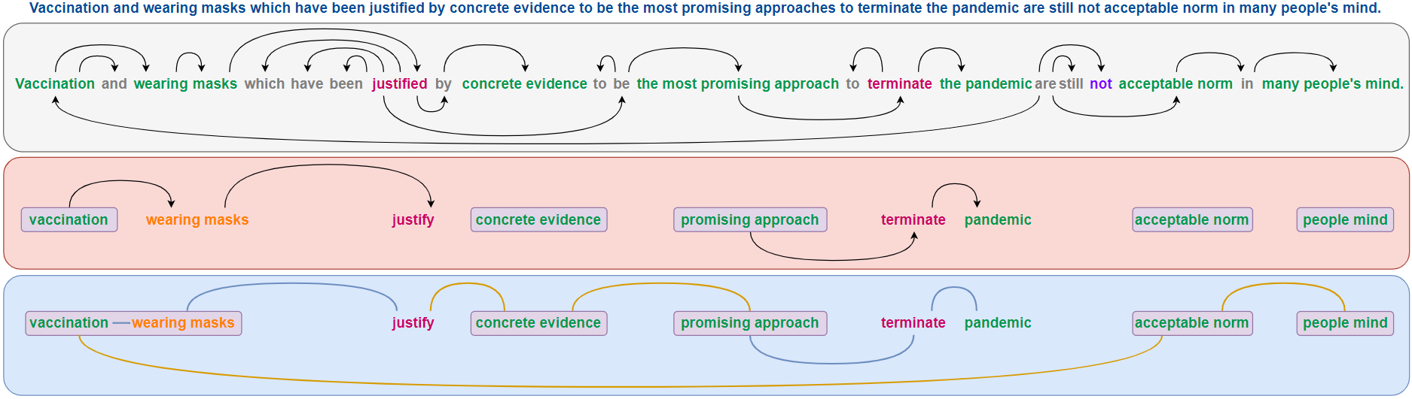
PKSG Pipeline: Semantic Units
Parsing
Pruning
Contraction & Rewiring
Noun Phrases: concrete evidence, promising approach, acceptable norm, people mind
Custom Phrase: wearing masks

Slide 14

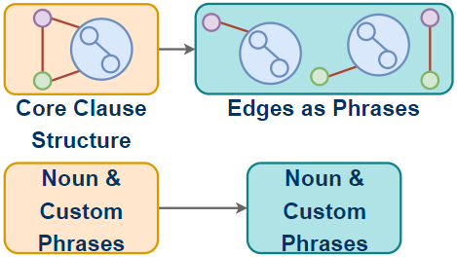
PKSG Pipeline: Phrases
Extracted Phrases:
(wearing masks)
(concrete evidence)
(promising approach)
(acceptable norm)
(people mind)
(vaccination, wearing masks)
(vaccination, justify)
(vaccination, acceptable norm)
(wearing masks, justify)
(wearing masks, acceptable norm)
(justify, concrete evidence)
(concrete evidence, promising approach)
(promising approach, terminate)
(terminate, pandemic)
(acceptable norm, people mind)

Slide 15
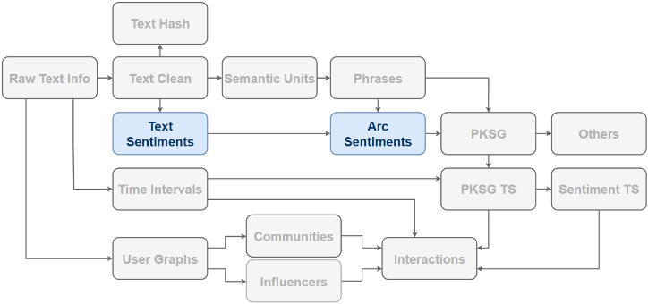
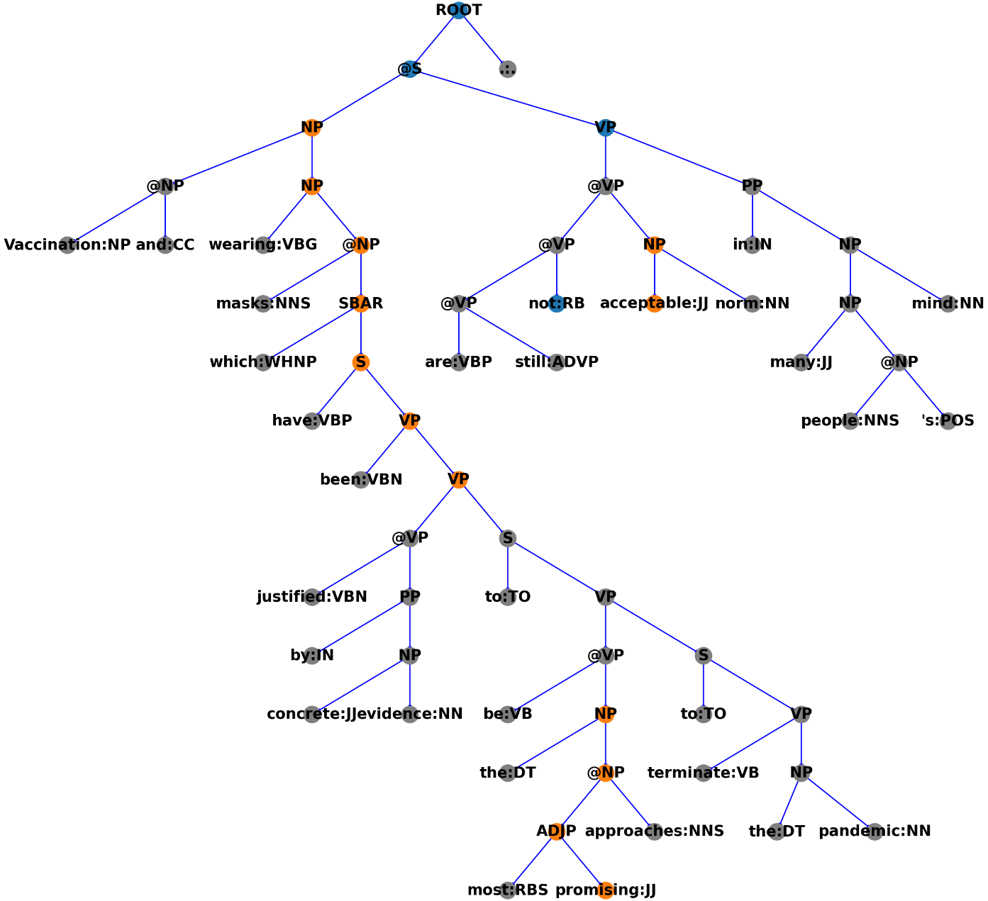
PKSG Pipeline: Text Sentiments
Stanford RNTN Sentiment Model
Constituent Sentiment Tree
Binary
Constituent-level sentiments
Lexicon for leaves
RNTN for internal nodes
Bottom-to-up inference
Stanford Sentiment Treebank
Negative
Positive
Neutral

Slide 16
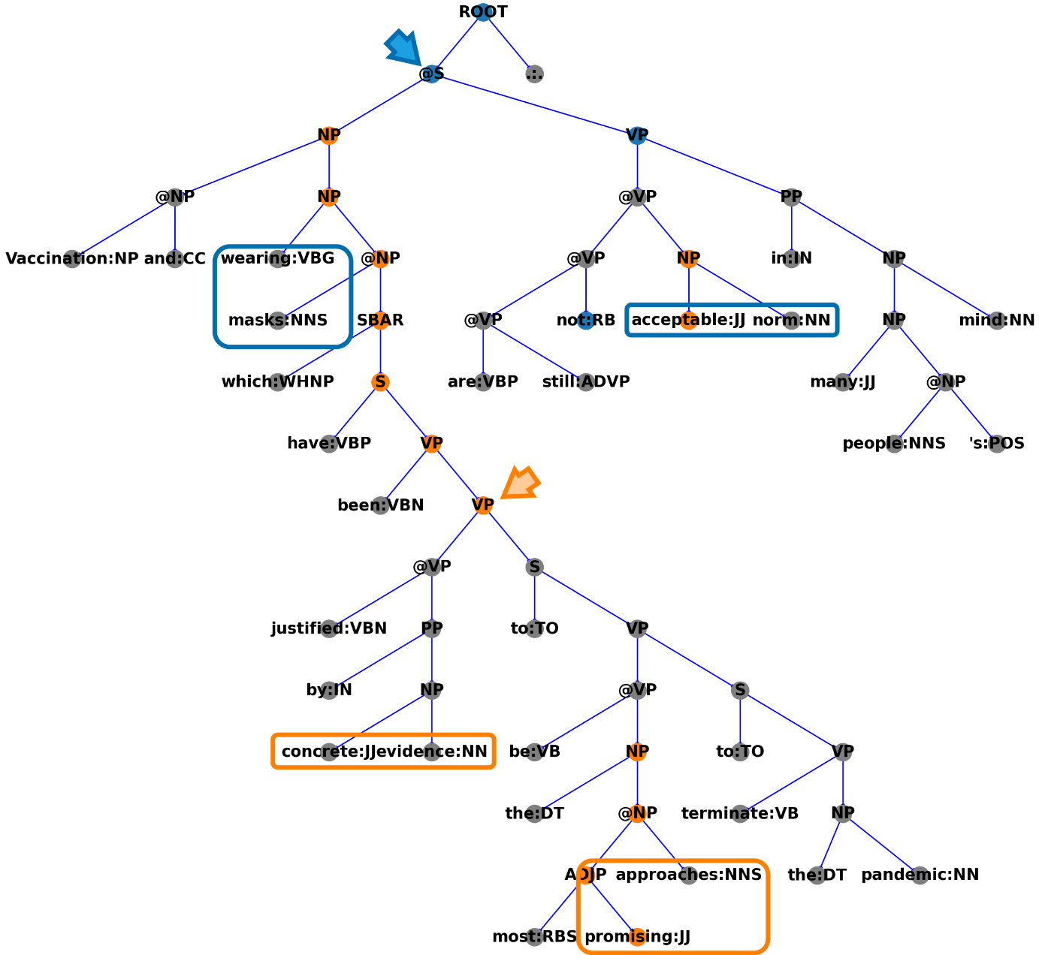
PKSG Pipeline: Arc Sentiments
Min Root
Arc
Formed by two phrases
Shallow syntactic info + Co-occurrences
Sentiments on Min Root
Find the min subtree containing the arc
Take the sentiments at the root
Min Root
Context Matters!
The arc
[wearing masks + acceptable norm]
is negative in this example.
Can be easily positive in some other sentences, e.g.
“Wearing masks is an acceptable norm.”
Negative
Positive
Neutral

Slide 17
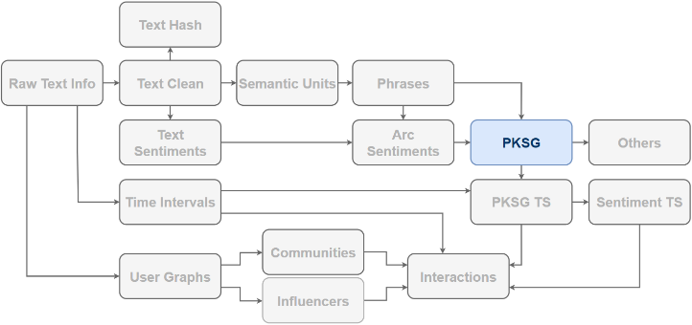
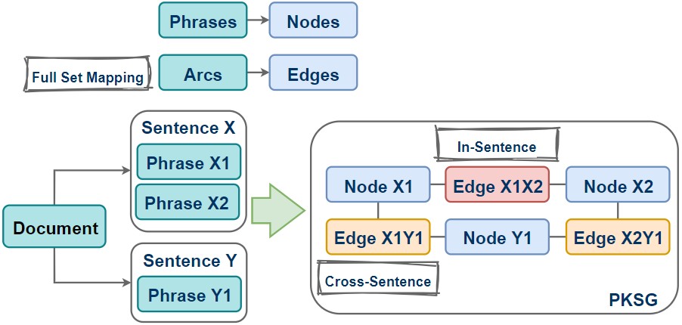
PKSG Pipeline: PKSG
Node
Lemmas
POS
Spans
Occurrences
Doc IDs
Edge
Sentiments
Co-occurrences
Phrase IDs
In-Sentence vs Cross-Sentence
In-Sentence: Arc Sentiments
Cross-Sentence: No Sentiments
Notes:
Why mapping the full set of arcs to edges?

Slide 18
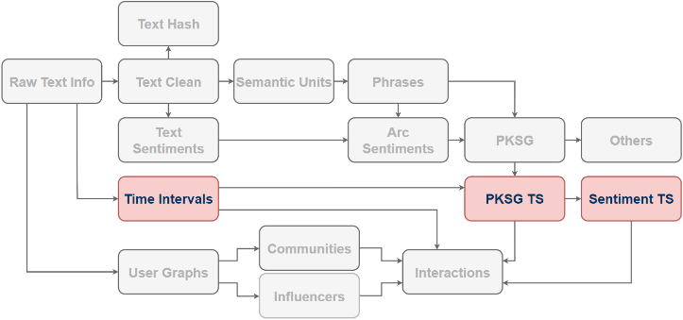
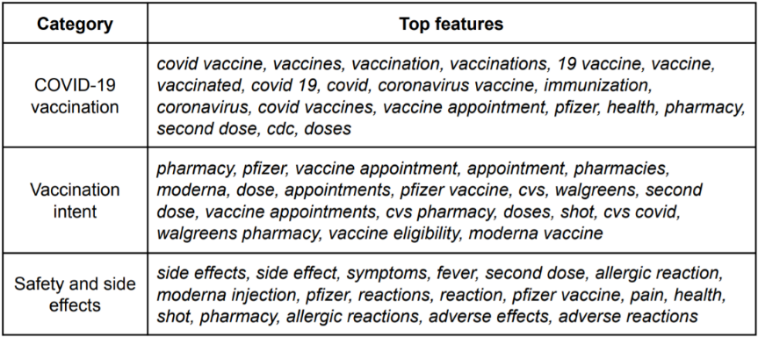
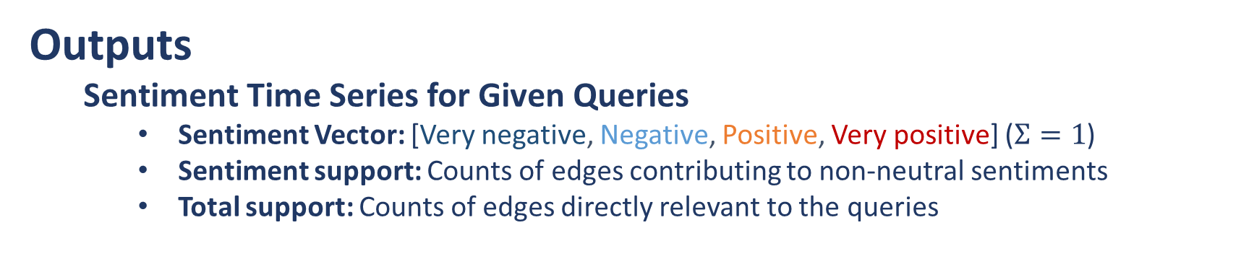
Sentiment Time Series
Inputs
Twitter data
Geo-Projection: If geo-info is available, e.g. CA, NY, FL and PA.
Queries
Inflectional morphology: E.g. {mask wear, mask wearing, wear mask, wearing mask, wearing masks}
Quotient
Time Series
Stride: E.g. 1 day
Span: E.g. 3 days
Outputs
Sentiment Time Series for Given Queries
Sentiment Vector: [Very negative, Negative, Positive, Very positive] ($Σ=1$)
Sentiment support: Counts of edges contributing to non-neutral sentiments
Total support: Counts of edges directly relevant to the queries

Slide 19
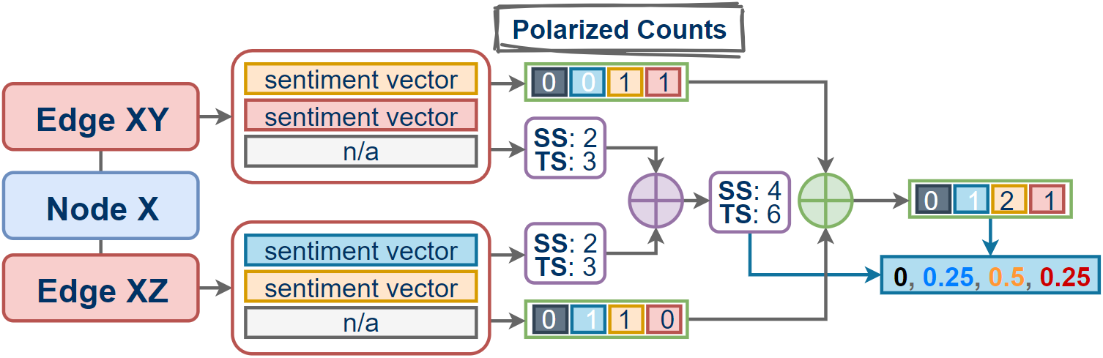
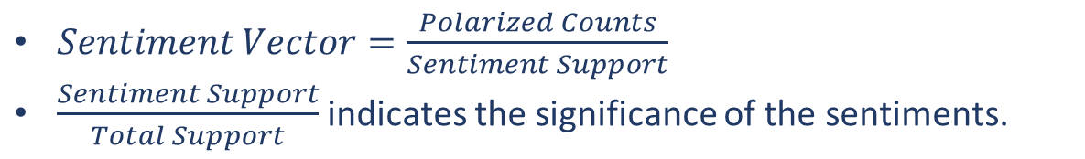
Sentiment Time Series
SS: Sentiment Support
TS: Total Support
Polarized Counting
$Sentiment Vector=\frac{Polarized Counts}{Sentiment Support}$
$\frac{Sentiment Support}{Total Support}$ indicates the significance of the sentiments.

Slide 20
Supplementary Slides

Slide 21
Sentiment Time Series Applications
Collaborate with Dr. Kathleen Carley @ CMU CASOS and Dr. Peter Pirolli @ IHMC (funded by IARPA)
Twitter Data
States: CA, NY, FL, PA
Sentiments of “vaccine”, from Jan. 31, 2020 to Nov. 26, 2020.
Sentiments of “mask wear”, from Jan. 31, 2020 to Nov. 26, 2020.
Nationwide
Three categories (provided by Google)
Sentiments from Jan. 2021 to Jun. 2021.

Slide 22
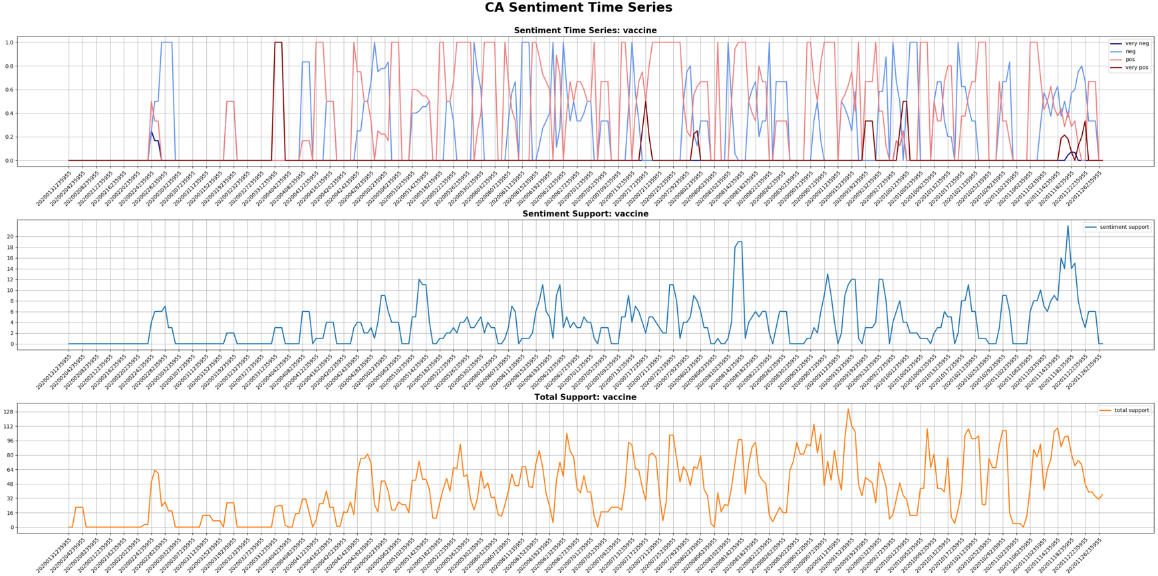

Slide 23
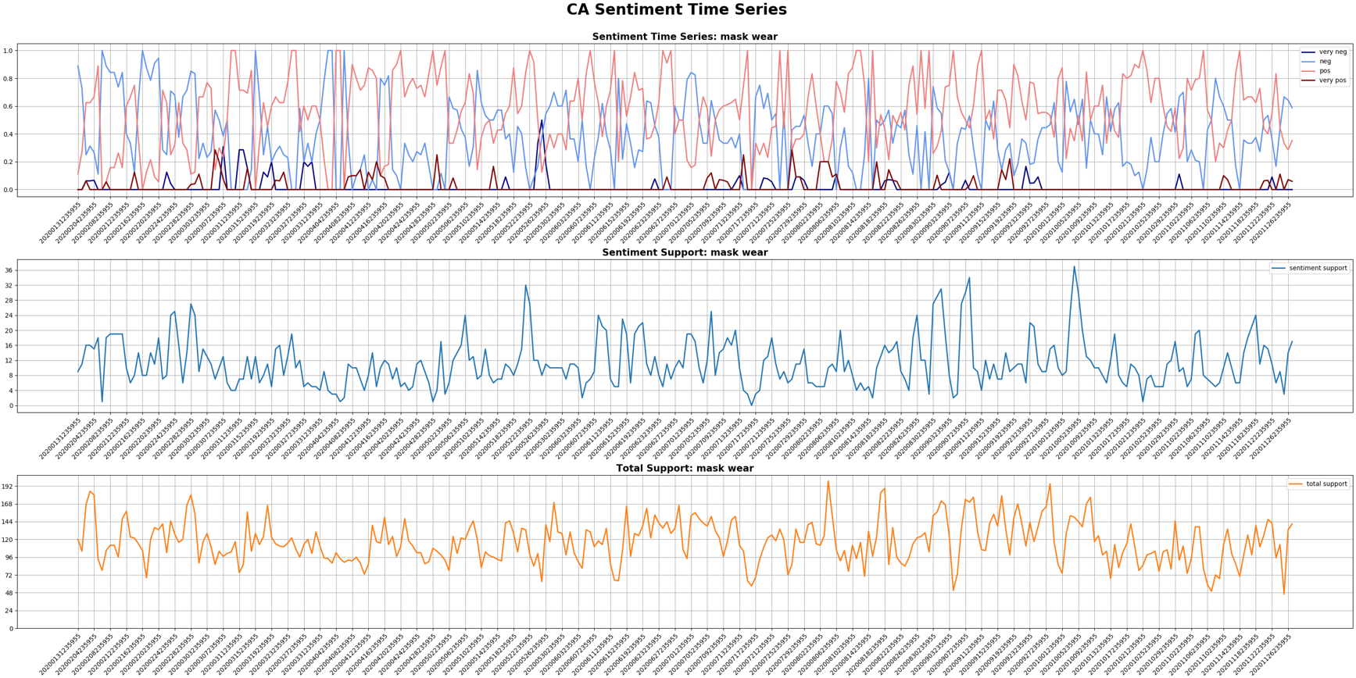

Slide 24
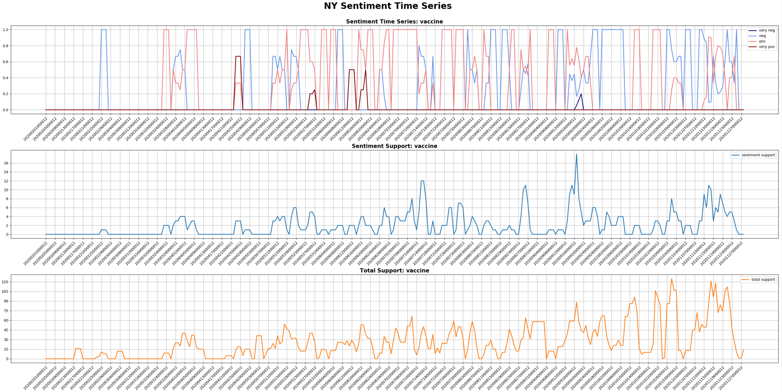

Slide 25
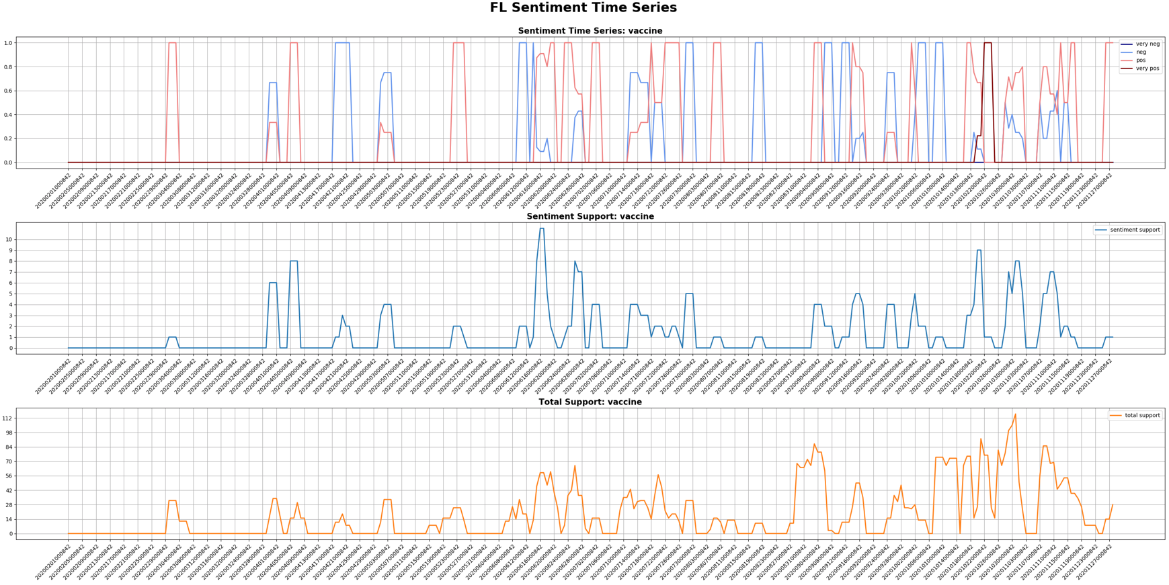

Slide 26
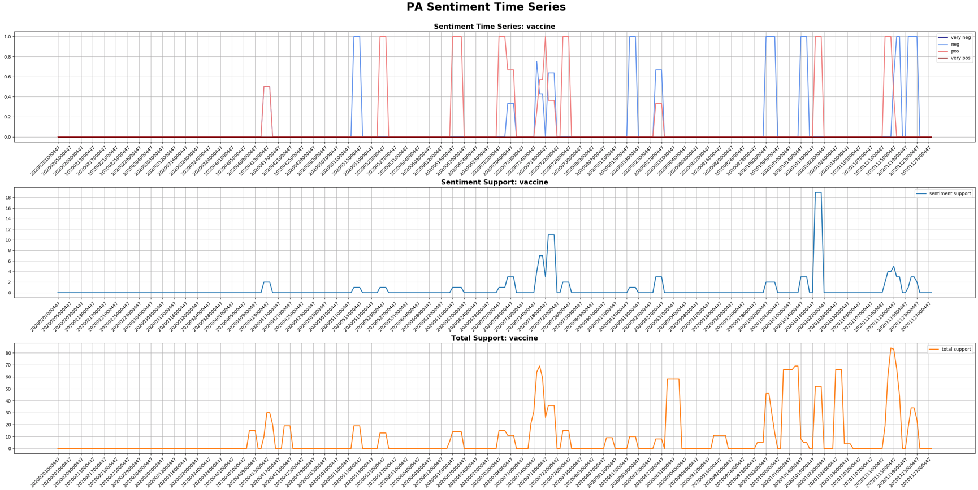

Slide 27
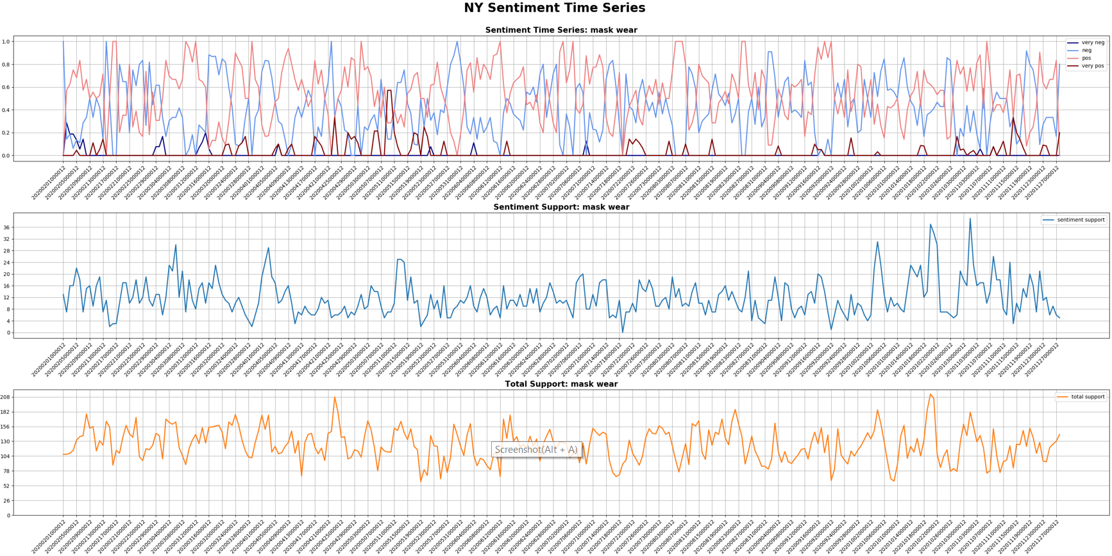

Slide 28
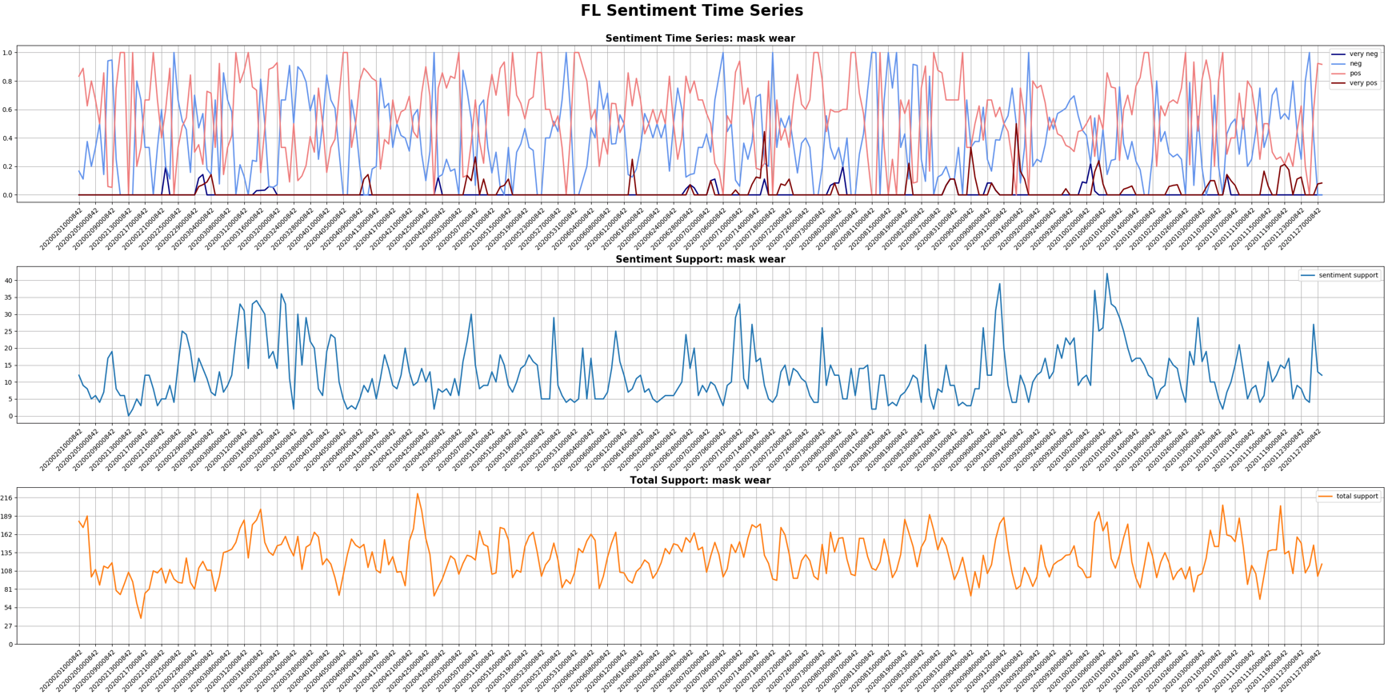

Slide 29
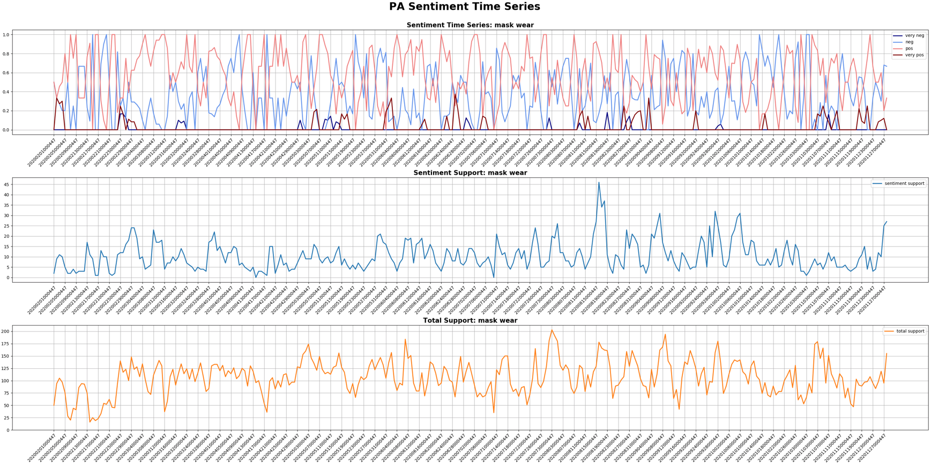

Slide 30
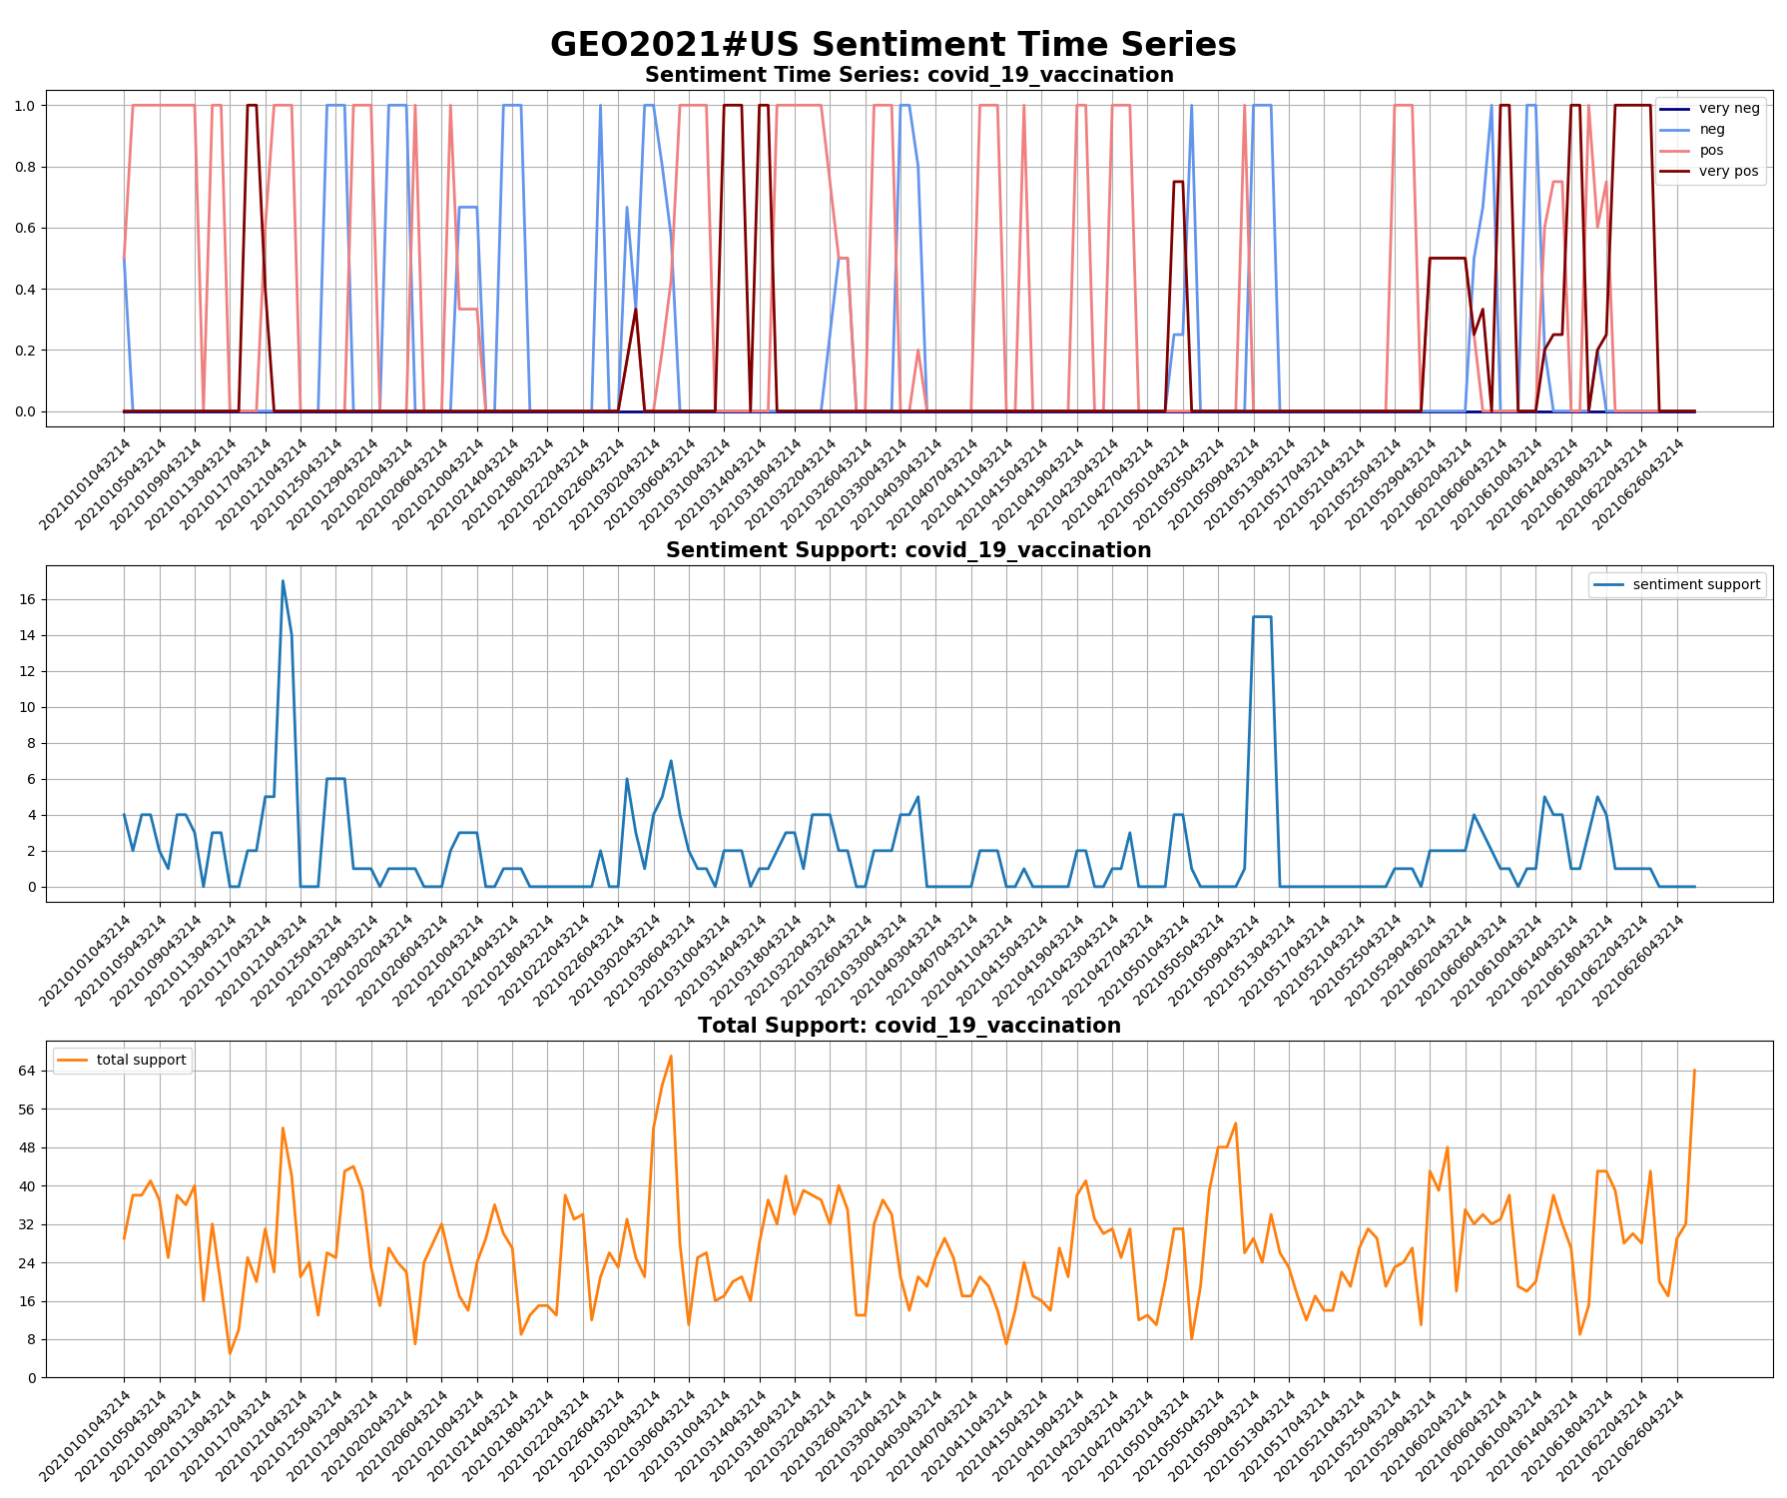

Slide 31
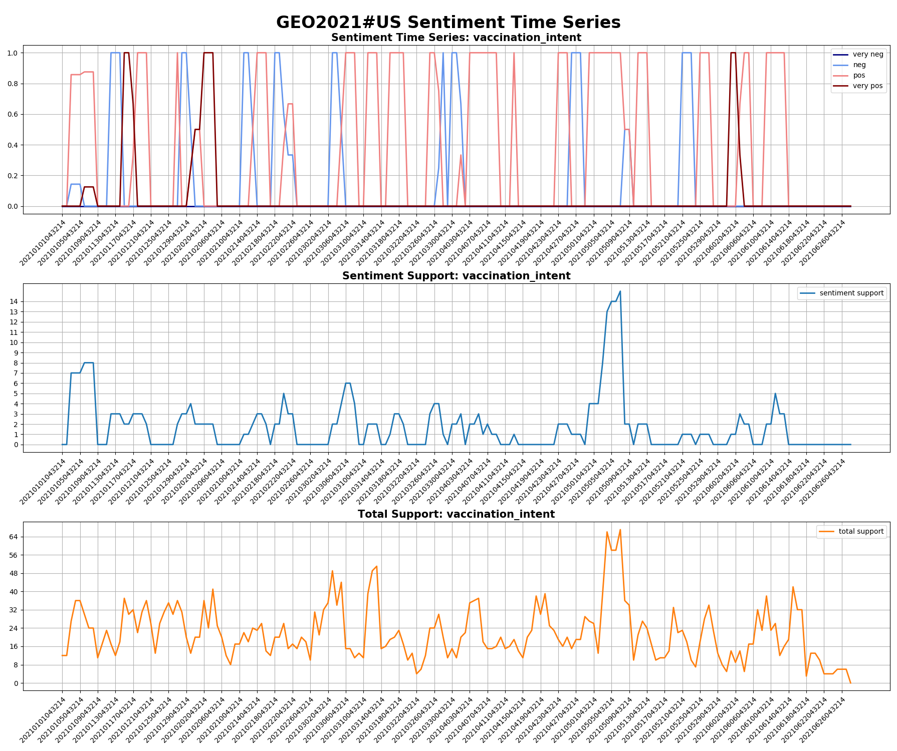

Slide 32
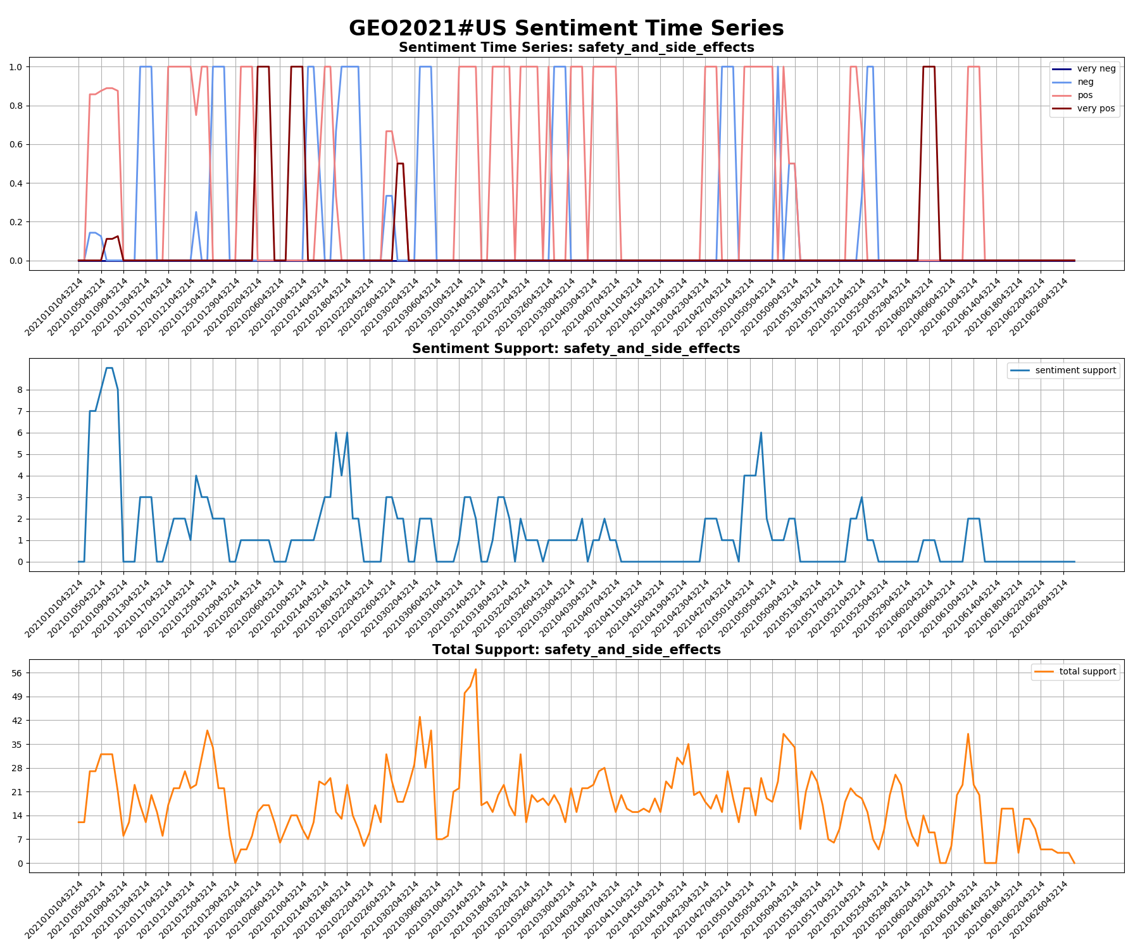

Slide 33
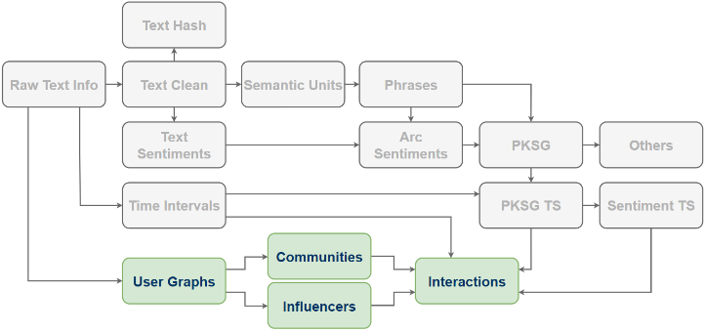
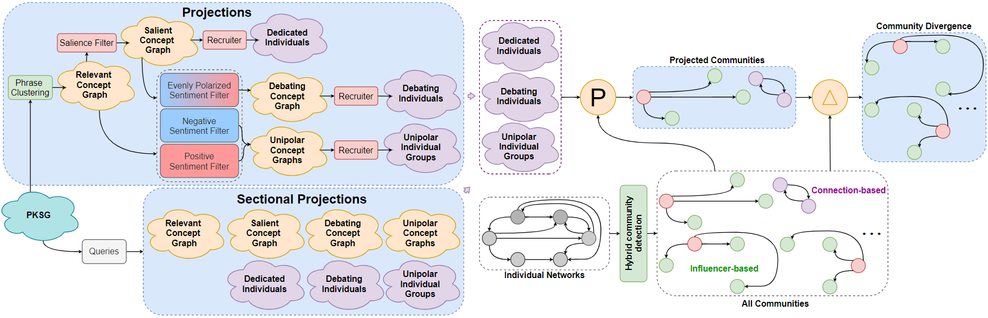
Individual Projections

Slide 34
Individual Projections
Individual Relationship Graphs (IRG)
Retweeting graphs: Capture belief propagation
Community structures
Influencers
IRG to PKSG
Any subgraph of an IRG can be mapped to PKSG
PKSG to IRG
Any subgraph of a PKSG can be mapped to IRG
Interactions Between IRG and PKSG
Many interesting finds

Slide 35
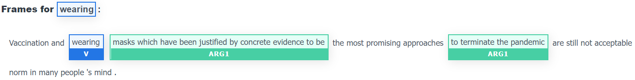
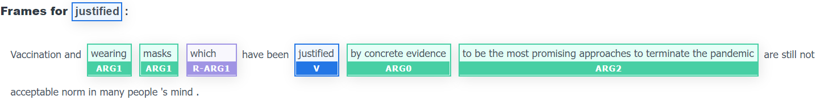
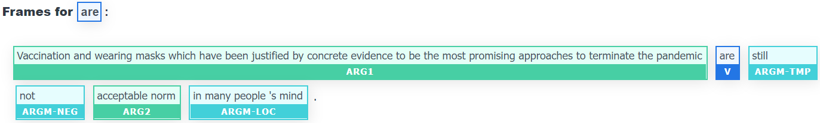
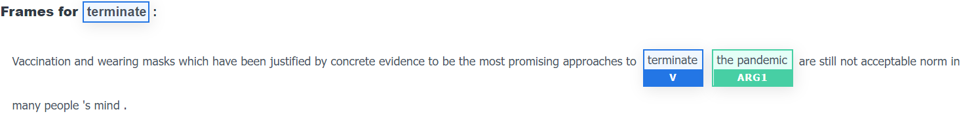
Alternative Method for Sentiments
Semantic Role Labeling
BERT based model (Simple BERT Models for Relation Extraction and Semantic Role Labeling)

Slide 36
Alternative Method for Sentiments
Sentiments on Argument Structures
RoBERTa based classifier (RoBERTa: A Robustly Optimized BERT Pretraining Approach)
“wearing masks which have been justified by concrete evidence to be to terminate the pandemic”: 0.73 negative
“wearing masks justified by concrete evidence to be the most promising approaches to terminate the pandemic”: 0.52 negative
“Vaccination and wearing masks which has been justified by concrete evidence to be the most promising approaches to terminate the pandemic are not acceptable norm”: 0.99 negative
“terminate the pandemic”: 0.60 positive

Slide 37
In-Progress Works
Vector and Bayesian Semantic Representations Derived From PKSGs
For any given subgraph in a PKSG, we seek a vector or Bayesian representation of the semantics carried by this subgraph. Bayesian representations are requested as forwarding uncertainties in semantics to downstream analyses and modeling helps produce more trustable results. Graph (variational) autoencoder models have been utilized in our experiments, and graph curvatures (e.g. Ricci) are used in detecting salient subgraphs (i.e. salient semantics in PKSG).
Vector Representations for Communities and Influencers
Representing communities and influencers in vectors is a necessary step in predicting the variation of community structures and influencers. The main difficulty of this problem comes from aligning communities and similar influencers over time. We found that many influencers are persistent over time and can help the alignment; however, the occurrences of influencers are usually not time consecutive. We conjectured that identifying similar influencers in terms of the patterns they aggregate individuals may help fill the gaps in time.

Slide 38
In-Progress Works
Two-Stage Sentiment Models & More Effective Detection of “Neutral”
Most popular sentiment models are supervised and trained on specific datasets. We found that the performance of such models may not be universally stable. Furthermore, the Attention mechanism has been playing the central role in most of these models. However, it was observed in our experiments that the attended tokens do not necessarily accord with human judgment on the sources of sentiments. In addition, these models are typically weak at detecting “neutral”. Motivated by these issues, we designed a new sentiment model consisting of two stages. In the first stage, salient components for sentiments are extracted from argument structures; and in the second stage, sentiments are determined on the salient components.

Slide 39
In-Progress Works
Interactive Models Between Semantics/Sentiments and Communities/Influencers
It has been known to us that semantics/sentiments and communities/influencers do have interactions, though the interactions may not be straightforward in observations. We have been seeking models that are able to describe such interactions, and thereby the predictions on these items can be conducted more accurately, and the prediction models are more interpretable. ACT-R has been introduced into my work, and we are interfacing it to PKSG.
Neurodynamics of RNN-Based Time Series Forecasting Models
RNNs have been widely used in constructing forecasting models thanks to its innate input-output mapper characteristics. However, most existing works on RNN-based models intensively concentrated on the model architectures and performance rather than the interpretability, which consequently results in misleading and confusion when applying these models in solving real problems. Understanding these models from the neurodyanmics perspective (e.g. how the attractors are distributed and what patterns they actually capture) is one of my featured in-progress works.

Slide 40
Interlude: Semantic Units
Are the dependency parsers trustable?
Fairly well.
How is the “Filter” configured?
POS combos and dependencies can be tricky. Noisy when too loose while missing important semantics when too strict. Needs better solutions.
How is negation handled?
For sentiments exclusively, negation cues can be dropped. The sentiments will not be affected. However, dropping negation may lead to issues when focusing on semantic representations.

Slide 41
Interlude: Phrases
How is this different from terminology extraction and text summarization?
Terminology extraction concentrates on terms highly relevant to a topic, usually noun phrases. Text summarization keeps the most important constituents and/or substitutes long utterances to shorter ones in very similar meanings. We focuses on the semantic fragments carrying the most important semantics without specific topics and reorganizing the texts.
How do you know the phrases are all important?
Most of them are important, though noise does exist. We have evaluated the quality of phrases utilizing SemEval2020T1 (aspect-based sentiment analysis). When exclusively considering positive and negative, the accuracy is about 60%-80%.

Slide 42
Interlude: Sentiments
Regarding detecting sentiments on “phrases”, why not the following idea?
Argument structure analysis
Sentence-level sentiments
Apply sentiments to detected objects/subjects
Issues
Sensitive to the accuracy of argument structure analysis, especially on texts not well-written.
Sentence-level Sentiments may not reflect actual sentiments on fine-grained objects (e.g. controversial).
However, this idea can be computationally more efficient.

Slide 43
Interlude: Sentiment Time Series
How do “stride” and “span” in time series affect the results?
Events happen. Skipping days may result in missing salient ones.
Given the timeline being fully covered, the larger the stride, the more general the sentiment trend.
Roughly, a surge caused by an event lasts for a couple of days. Mostly, short spans are fair if the stride is not too large.
Why is “neutral” not considered in the sentiment vector?
Neutral texts are dominant.
The significance of sentiments matters!

Slide 44
Interlude: PKSG
How has PKSG been evaluated?
On the quality of phrases, we have done preliminary evaluations, though more may be needed.
On other aspects, we need more rigorous and reasonable tasks for the evaluation.
How long will it take to have sentiment TS for a whole month Twitter data?
Depends on the size of data. Roughly, a couple of days for <100GB data with 10 nodes.

